Slide 1

Workshop on
Programming

Slide 2
What you will learn today
What you will make today
Text output in Python
Data types and where they are used
Boolean operators
Storing elements in a list
Program flow methods
Functions and their use in Python
Final Project!
Choose between three different projects: text-based adventure, tic tac toe, or battleship
40-45 minutes of session to complete
Notes:
Monisha start

Slide 3
Today’s Software: repl.it
We will be using repl.it as our Python IDE today.
To open, type this link in your browser: https://repl.it/languages/python3
On the top right corner, you will see a “Log In” button. You may log in with your Google or Facebook account in order to be able to save your work.
(If you don’t have either, you may Sign Up with your email)
Notes:
5 min

Slide 4
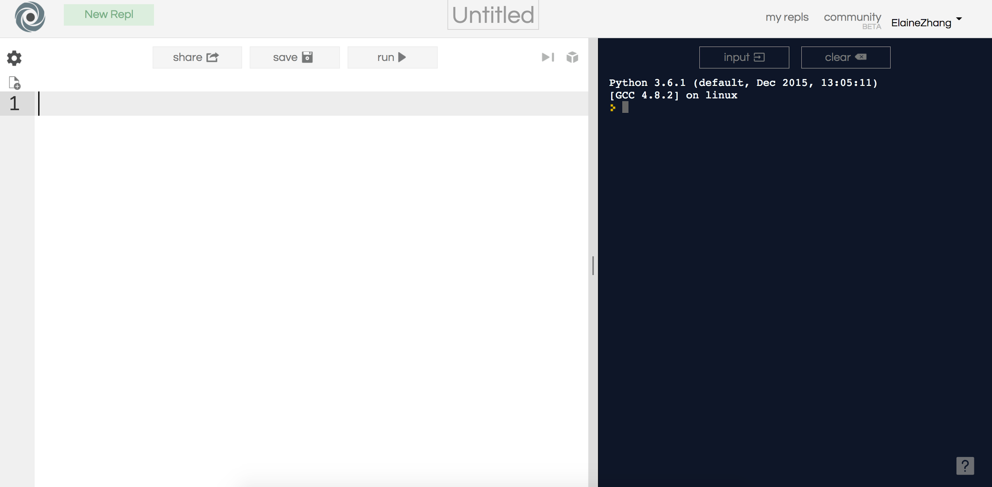
How to use repl.it
Try typing in “import this” and run the code!
< create new file
remember to ^ save your code!
^ click to run code
console

Slide 5
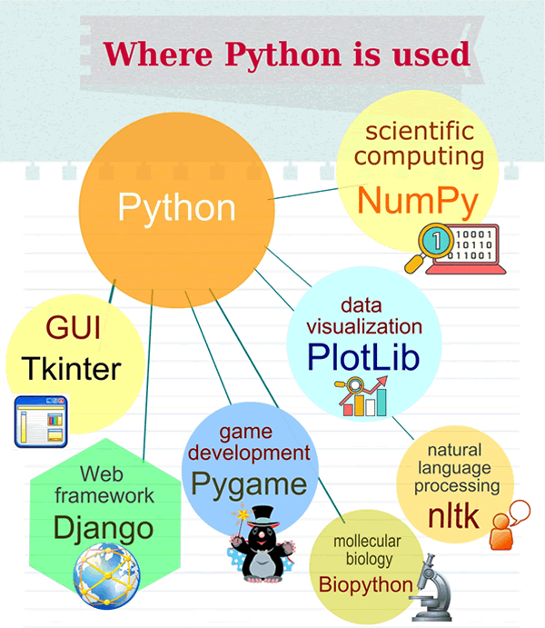
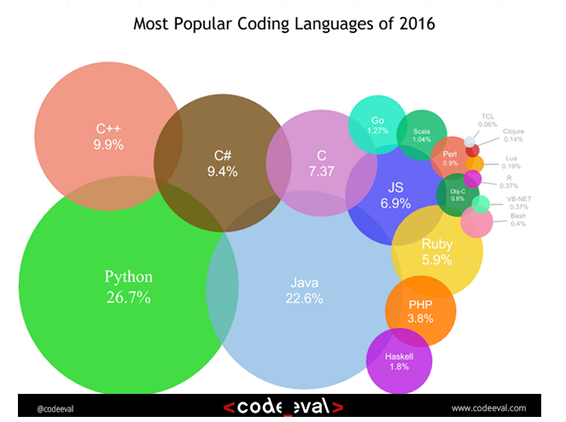
Where is Python used?
Feel free to interrupt and ask questions!
Notes:
5 min
ADD MORE COMPANIES
Philips: Automation is essential in the semiconductor industry, so imagine trying to coordinate the effort of thousands of robots. After a number of solutions, Philips decided to go with Python for the sequencing language (the language that tells what steps each robot should take).
United Space Alliance: This company provides major support to NASA for various projects, such as the space shuttle. One of its projects is to create Workflow Automation System (WAS), an application designed to manage NASA and other third-party projects. The setup uses a central Oracle database as a repository for information. Python was chosen over languages such as Java and C++ because it provides dynamic typing and pseudo-code–like syntax and it has an interpreter.
HP: Finding what you need on a corporate network is difficult. Most organizations implement a custom search application or use off-the-shelf software to ensure that employees can find the information they need quickly. In this case, the search software began life as Infoseek, changed names to Verity Ultraseek, and is finally known today as HP Autonomy. The use of Python makes it easy to modify the search engine to meet specific needs. In addition, Python provides smoother multithreaded operation than some other languages, such as Java, do.
Honeywell: Documenting large systems is expensive and error prone. Honeywell uses Python to perform automated testing of applications, but it also uses Python to control a cooperative environment between applications used to generate documentation for the applications.

Slide 6


How many of you use Instagram?
Same goes for YouTube!
Instagram API and web app was built on Python!
"Python is fast enough for our site and allows us to produce maintainable features in record times, with a minimum of developers," said Cuong Do, Software Architect, YouTube.com
Every time you watch a YouTube video, you are executing a bunch of Python code!

Slide 7
Hello World!
Let’s start programming!
Print statement
Line of code that will output, or print, words to the console
print(“This is an example.”)
Try writing a line of code that’ll print out “Hello World!”
Feel free to interrupt and ask questions!
Notes:
5 min

Slide 8
Naming variables
A variable is a name that has a value associated with it.
Typically, variable names include lowercase letters, underscores between words and no special characters or keywords (like print or def). This is a convention used for the python language. Other languages may have their own convention.
variable_name = “value” ^ ^ Name of variable value associated with variable (can be a number or text)
Feel free to interrupt and ask questions!
Notes:
Elaine start

Slide 9
Data Types in Python
Python stores different kinds of variables and inputs as different data types
Numbers
Int, Float
Text
String
Boolean
True/False
Feel free to interrupt and ask questions!

Slide 10
Int/Float/Str
Int (short for integer):
Includes all whole numbers
Float:
All approximated real numbers
When integers and floats are mixed during division, result is always a float
Str (strings):
A string is a sequence of 0 (null) or more characters enclosed by single quotes or double quotes.
Typecasting—changing the type of a variable
str(variable), float(variable), int(variable) << changes variables into a string, float, and integer, respectively
Feel free to interrupt and ask questions!

Slide 11
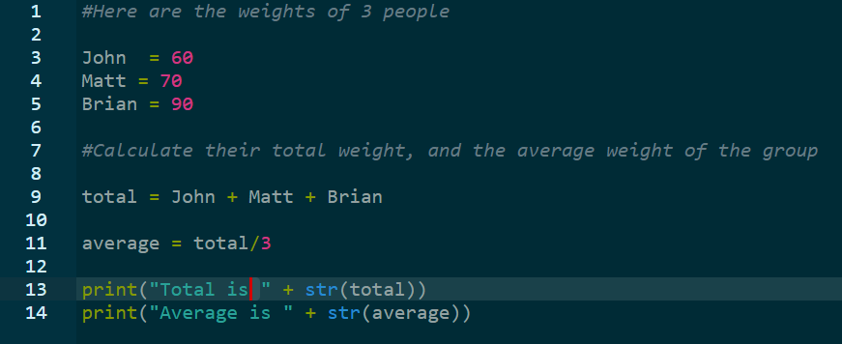
Activity
Feel free to interrupt and ask questions!

Slide 12
Boolean/Operators:
These operators are useful for conditions in program flow, which we will cover in a few slides.
Booleans:
Always True or False
Comparison Operators:
< , <= , > , >=
Relational Operators:
== , !=
Logical Operators
or, and, not
Use relational operators to create an expression that should return either True or False
Use logical operators to check for multiple expressions in one conditions (i.e., you want x > 3 and y< 5 to be both True before the code runs)
Feel free to interrupt and ask questions!

Slide 13
Storing Data: Lists in Python
Lists can store numbers, strings or even boolean values
They are a sequence of values that have some meaning
For example, here is a list of scores that students got in an exam:
The values are separated by commas, and enclosed in square brackets.
scores = [ 59, 61, 63, 63, 68, 64, 58 ]
Feel free to interrupt and ask questions!
Notes:
Monisha starts

Slide 14
Why use lists?
Lists allow us to perform operations on groups of data at once. For example, if the values are all int, we may find their sum or even average!
Each element in a list has a corresponding index, that denotes its position in the list. In python, indices start from 0. So in our “scores” list, 59 has an index of 0, 61 has an index of 1, and so on.
This system of indices allows us to perform operations on individual elements in the list as well. For example, we can access the score 68 by typing print(scores[4])
scores = [ 59, 61, 63, 63, 68, 64, 58 ]
Try typing print(scores[-1]) and see what happens!
Feel free to interrupt and ask questions!

Slide 15
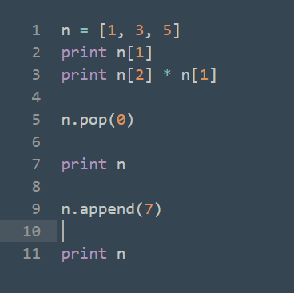
Add and remove elements from a list
Consider the given list n containing 3 values. We can apply mathematical operations on individual elements as well as add/remove elements using the append() and pop() functions respectively
ACTIVITY: Write a program that takes a list with more than 3 elements, removes the second element, then adds the removed element to the end of the list. Print the list after each action.
Feel free to interrupt and ask questions!

Slide 16
Have a 10 minute break!
Github link:

Slide 17
Program Flow in Python
Types of flow:
If/Elif/Else statements
For loops
While loops
Feel free to interrupt and ask questions!
Notes:
Elaine starts

Slide 18
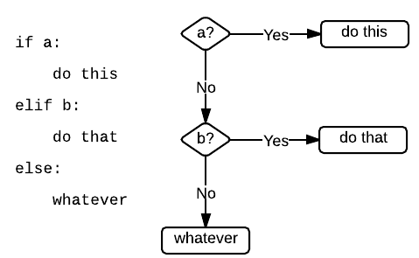
If/Elif/Else Statements
If/Else statements have this general structure:
if condition_1: Block of code to be executed elif condition_2: Block of code to be executed else: Block of code to be executed
Feel free to interrupt and ask questions!

Slide 19
Activity: Simple If/Elif/Else code
Here is an example:
number = int(input(“Enter an integer: ”)) if number < 5: print(“Number is less than 5!”) elif number > 5: print(“Number is greater than 5!”) else: print(“Number equal to 5.”) print(“Good bye!”)
Indentation is important!

Slide 20
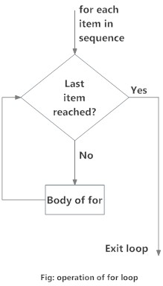
For loop
Used to loop through a block of code a certain number of times.
Sequence is typically a list, and you can use the range(a,b) function to loop a specific number of times.
Range(start, end): First number is the number you start at. Second number is the number you end at (loop does not include that number!).
for item in sequence: Block of code to be executed
Feel free to interrupt and ask questions!
Notes:
Monisha starts

Slide 21
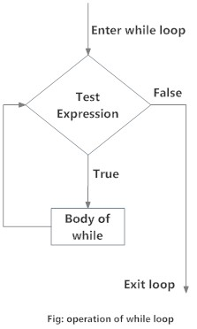
While loop
Used to loop through a block of code until the defined condition is no longer met.
while condition: Block of code to be executed
Feel free to interrupt and ask questions!

Slide 22
For loop vs While loop
Here’s an example of a For loop and a While loop that prints the same output. Notice the differences in the two loops.
Warning: Make sure your while loop has an end! An infinite loop will crash your program.
sum = 0 number = 0 while number < 10: print(number) sum = sum + number print(“Total sum: ” + str(sum)) number = number + 1
sum = 0 for number in range(0, 10): print(number) sum = sum + number print(“Total sum: ” + str(sum))
CHALLENGE: Code a program that will print out the first 6 numbers of the Fibonacci series (1, 1, 2, 3, 5, 8…)
Feel free to interrupt and ask questions!

Slide 23
Operators with Program Flow
Often conditions used in program flow are expressed using operators.
Relational Operators:
== , !=
Logical Operators
or, and, not
Use relational operators to create an expression that should return either True or False.
if x == 3:
#code block that runs when condition is true
Use logical operators to check for multiple expressions in one conditions
Ex: you want x > 3 and y < 5 to be both True when the code runs
while (x > 3) and (y < 5):
#code block that runs when condition(s) are true
Feel free to interrupt and ask questions!
Notes:
Elaine starts

Slide 24
Break time! (10 minutes)
Github link:

Slide 25
Review of what was learned so far
Applications of Python today
Output to a console
Different data types
Boolean operators
Storing data: lists
Program flow: if/elif/else, for, while.
Feel free to discuss with your peers, or ask the instructors for any help that you need!
Coming Up: What are functions?, Common coding errors, and a fun project!
Github link:
Notes:
5 min exercise

Slide 26
Introduction to Functions in Python
Why do we need to use functions (also known as methods)?
Repeating same calculation for different inputs may be annoying
More likely to make an error
Using functions makes program more efficient and readable!
Learn a programmer’s motto: DRY – don’t repeat yourself.
Feel free to interrupt and ask questions!
Notes:
Monisha starts

Slide 27
How do functions work?
A function essentially does 3 things:
Takes 0 or more arguments as input. (can be a number, text or even lists, etc)
Computes a new value, a string or a number.
Returns the value
This value can be assigned to a variable, sent as output to the console, or passed to another function.
Feel free to interrupt and ask questions!

Slide 28
Activity: Write a function to compute area of a square
We know that the area of a square is the square of the length of one side. Hence the length of the side is our argument.
In Python, to define a function, we use the “def” keyword, as shown in the example.
def area_square(side): area = side**2 return area print(area_square(2)) print(area_square(3))
ACTIVITY: Try writing a function to calculate the area of a triangle and a circle.
Feel free to interrupt and ask questions!

Slide 29
Scope of a variable
Variables are categorized in two ways, local and global.
Local variables
Defined and used only within a function
Once the function ends, the value attached to the local variable disappears
Global variables
Defined at the beginning of the program
Can be used throughout the whole program
Feel free to interrupt and ask questions!
Notes:
Elaine starts

Slide 30
Examples for global vs local variables
x = 10
def change_x1():
x = 20
print(x)
change_x1()
print(x)
Results:
20
10
x = 10
def change_x2():
global x
x = 20
print(x)
change_x2()
print(x)
Results:
20
20
Feel free to interrupt and ask questions!

Slide 31
Common mistakes in programming
Infinite loop—when the condition for your while loop is never false
Out of bounds index—make sure that the index you are passing to a list is within bounds (from 0 to 1 less than the length of the list).
Working with variables of different data types—typecast variables when necessary
Bad example: string_sentence = “This is a number: ” + 0
Good example: string_sentence = “This is a number: ” + str(0)
Not returning a value from a function

Slide 32
Final Project
There are three projects for you to choose from today.
Project 1: Text-Based Adventure
Project 2: Tic Tac Toe
Project 3: Battleship
Feel free to interrupt and ask questions!
Feel free to interrupt and ask questions!

Slide 33
Work on your project!
Github link:

Slide 34
Like what you learned?
Here’s some resources you can use to advance your coding adventure!
Websites:
www.codecademy.com
www.learnpython.org
www.coursera.org/learn/python
Other options:
Play with microcontrollers (Arduino, Raspberry Pi etc.)
Note: These microcontrollers use a different programming language

Slide 35
Thank you and keep on learning!

